Slide 1
Resiliency in Children
Grata, Michelle, Allison, Melva

Slide 2


Slide 3
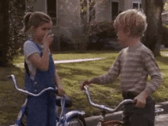
Introduction to Resilience
We tend to think of childhood as a carefree time, but there are many social, emotional, and physical challenges that children deal with.
In the classroom: Children may deal with problems ranging from adapting to a new classroom, failing an assignment, isolation and even to bullying by classmates.
At home: Students may deal with death, abuse, instability, divorce and etc.
“The ability to thrive despite these challenges arises from the skills of resilience…”
https://www.psychologytoday.com/blog/creative-development/201407/the-resilient-child

Slide 4
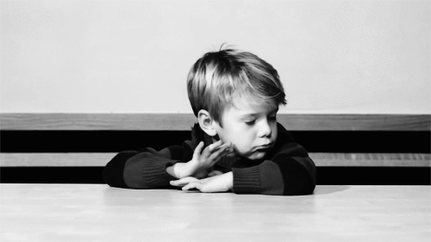
Introduction to Resilience
The good news is that resilience skills can be learned!
“Building resilience — which is “the ability to adapt well to adversity, trauma, tragedy, threats or even significant sources of stress” — can help our children manage stress and feelings of anxiety and uncertainty”
  Psychology Today, APA

Slide 5
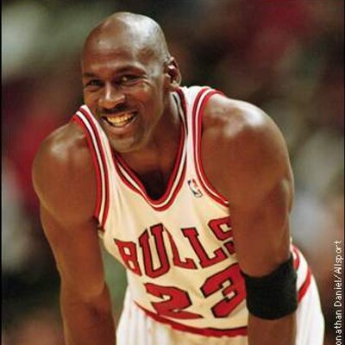
What is Resilience?
"The ability to recover from or adjust easily to misfortune or change; the ability to bounce back or recover is important
“A resilient child recovers from challenges, but they’ve learned to do more than that. They actually hold a different mindset.”
--Psychology Today

Slide 6
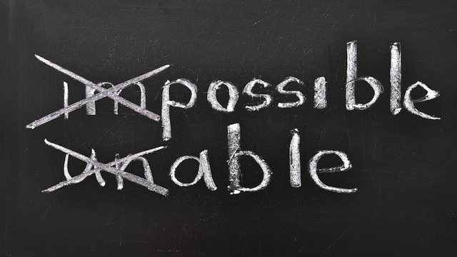
Changing their mindset
A mindset of resiliency says: I am not my mistakes, I can try again, things will get better, and I am not alone.
  Whether it’s failing an exam, not getting picked for a sports team, or forgetting your lines in the school play, the process of childhood includes making mistakes.
However, the resilient child has somehow learned to pick him or herself up and keep going. --Psychology Today

Slide 7
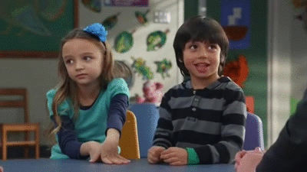
the resiliency mindset
Mindset– If students can learn that within them is a power to overcome any obstacle, they can pick themselves up and move forward
Instead of saying “I failed. I am a failure,” a child with growing resilience would say, “I failed. I can try again. I have what it takes.”
They can learn to endure disappointment and not get devastated from it.
Connection: Children who grow resilience are connected to other people. Children that have authentic relationships and can genuinely talk to someone that is nonjudgmental when mistakes happen can grow resilience. --Psychology Today

Slide 8
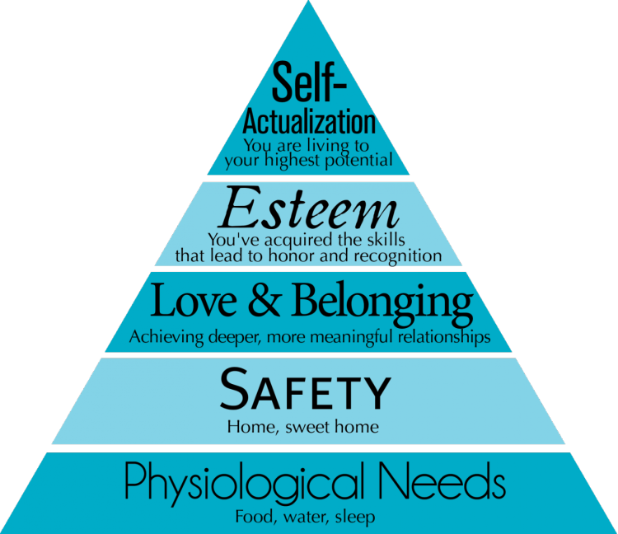
Goal of A resilient Mindset
For our students to learn that they aren’t their mistakes and that failure is a necessary step toward success!!!!!

Slide 9
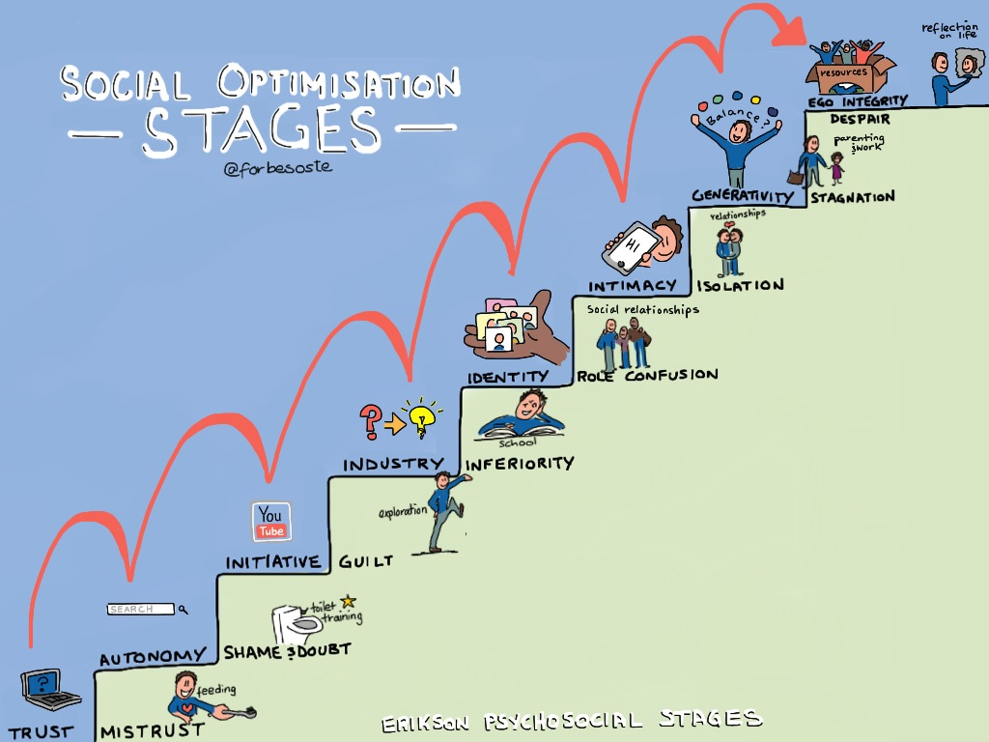
Erik erikson
Erikson’s (1959) theory of psychosocial development has eight distinct stages, based on overcoming a social crisis that occurs at each stage.
Erikson suggests that there is still plenty of room for continued growth and development throughout one’s life.
Psychosocial crisis involve psychological needs of the individual conflicting with the needs of society
According to Erikson, if an individual is successful at each stage it results in the development of a healthy personality and the acquisition of basic virtues.
https://www.simplypsychology.org/Erik-Erikson.html

Slide 10
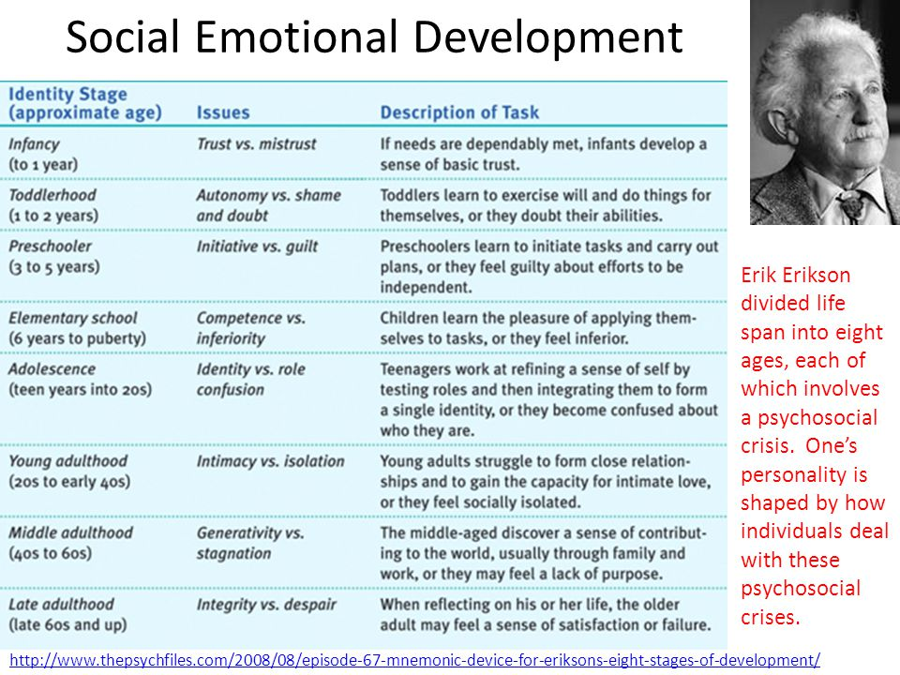

Slide 11
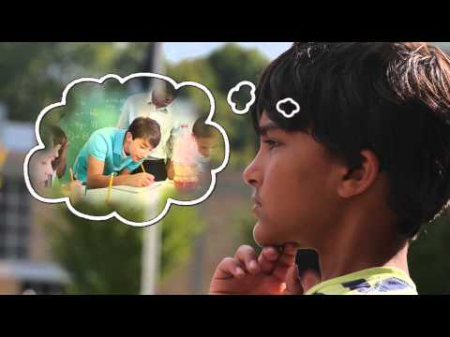

Slide 12
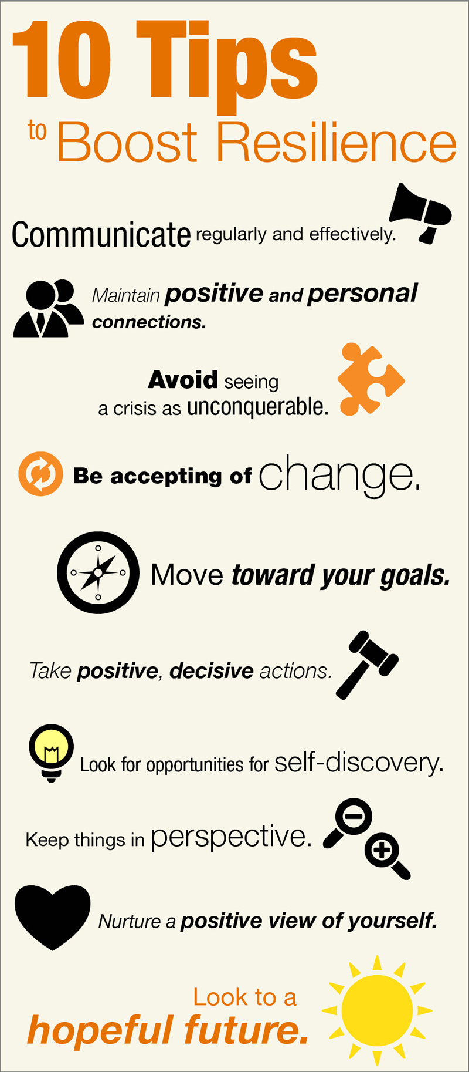
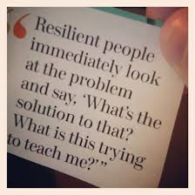
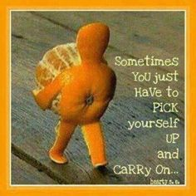
Ways to instill resiliency
We all can develop resilience, and we can help our children develop it as well. It involves behaviors, thoughts and actions that can be learned over time. Following are tips to building resilience.
Encourage them to be a friend
Teach how to stay focus and know when to take a break
Teach self-care (making time to eat properly, exercise and rest)
Set goals with realistic steps and be aware of challenges
Positive self-view (how he/she has handled hardships to build strength)
Keep things in perspective and maintain a helpful outlook (life moves on even after bad events/history)
Change is part of life
Notes:
Make connections for friendships and empathy
Teach Empathy
Maintain Routine
Take breaks for fun
Be a positive model of a healthy
Teach perspective
Nurture a positive self view
Look for opportunities for self discovery
Understand that change is a part of growth

Slide 13

Resiliency Quiz
What’s your level of resiliency?
http://resiliencyquiz.com/index.shtml
Scoring:
80 or higher very resilient!
65-80 better than most
50-65 slow, but adequate
40-50 you're struggling
40 or under seek help!

Slide 14
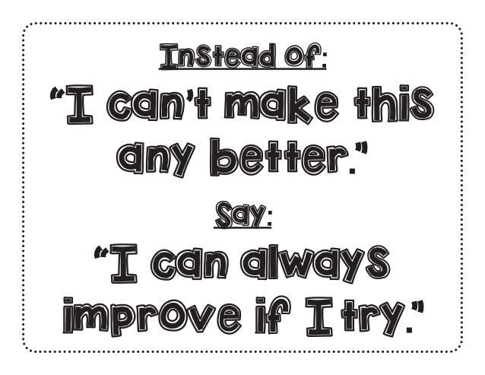
Strategies for building Resiliency in the Classroom
Keep perspective.
To teachers, it may be a small thing (one quiz grade, missing a turn at the block center, presenting in front of the class), but to the student, it may be a disaster. Keeping perspective isn’t about minimizing the problem or insisting that it could be worse: It’s about problem solving.
What teachers can do:
Triage the situation: Help the child think about other quizzes that are coming up, the time he spent at the block center yesterday, or the way she prepared for the presentation, to show them that this is one event among many. Then, plan ways to tackle these stresses in the future.

Slide 15
STRATEGIES FOR BUILDING RESILIENCY IN THE CLASSROOM
Short Term:
Capture the opportunity.
It is a disservice when teachers step in too soon so they never experience making mistakes. In fact, children learn more when allowed to make mistakes. It’s all in how they are taught to handle it.
What teachers can do: Praise effort: What you praise shows what you value. So focus praise on kids’ effort or creativity. A huge mistake could show a lot of creativity and ingenuity, even if the outcome is a disaster.
Cool down.
Of course, the best time to teach cool-down strategies is before kids get upset, but in-the-moment is the time to get them to practice those strategies.
What teachers can do: Cool-down corner: Create a cool-down corner with heavy pillows and calming music with headphones, or books. Teach older kids to count to 10 while taking deep breaths or to distract themselves by reading or writing until they’ve calmed down.

Slide 16
Strategies for building Resiliency in the Classroom
Long Term:
Create connection.
Relationships are key to resiliency, and it’s not the number but the quality that counts. In addition to the emotional benefits, the best way to learn how to deal with minor stresses is to have it modeled by peers.
What Teachers Can Do: Spin a web. Create a web that shows how the kids are all connected to one another. Then, use that web to figure out where and how you can build new connections.Instead of doing show-and-tell or another presentation, pair kids up and have them teach one another something they know, share a book they read or explain a favorite hobby.
Build competence.
Every student is good at something. In particular, students may struggle when they don’t see the connection between their strengths transfer across situations—think of the student whose multiplication skills are strong, but he struggles to apply them to word problems.
What Teachers Can Do: Compliment cards: Make it a habit to leave sticky notes with compliments on your students’ desks. Plan out a delivery schedule that will make it feel random to keep them pleasantly surprised. Even better, use those compliments to call out students for their strengths—during a social studies project, ask a curious child to create a list of questions about the Revolutionary War, for example.

Slide 17
Building Resilience in Classrooms (Cont.)
Give them options.
Choices give kids power and self-determination, plus it lets them make choices and live with the consequences, however minor. Giving kids authentic (not false) choices doesn’t have to be complex—choices around how to complete an assignment are enough.
What Teachers Can Do: Choice boards. Provide a list of choices that students can make with each assignment. For younger students, this could be a limited list of options (answering questions out of order, choosing to skim a passage before reading it). For older kids, this could be a discussion about different ways to approach a project.
Connect with characters.
Books are a great jumping-off point for talking about resiliency. For example, Chester’s Way and Sheila Rae, the Brave by Kevin Henkes, novels like Hatchet by Gary Paulsen, and biographies provide a lot to talk about when it comes to resiliency.
What Teachers Can Do: Focus on control. During discussion, focus on the choices the character made. This helps students understand that how we handle situations is within our control. And ask: What other choices could the character have made? And how would it have changed the outcome?
Encourage constant progress.
Setting and achieving goals builds the practice of self-monitoring and helps students see the results of their hard work. The trick isn’t in setting goals but in sticking with them.
What Teachers Can Do: Stair steps. Have students set big goals, and identify a few steps along the way. Then, have students reflect after each step about what helped them get there and what they want to keep, or stop, doing.

Slide 18
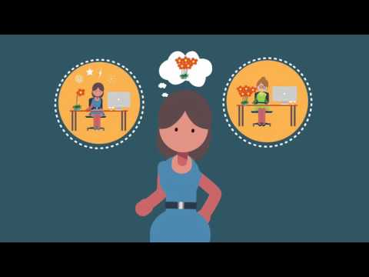

Slide 19

Summary
The great news is that resilience isn’t a biological gift from great parents.
It is something anyone can learn to grow in themselves or their children.
The point is that you can consciously plant the seeds of strength and resiliency in your children so they can overcome challenges and courageously give the gifts they were born to give.
-psychology today

Slide 20
resources
Psychology Today: https://www.psychologytoday.com/blog/creative-development/201407/the-resilient-child
American Psychological Association: http://www.apa.org/helpcenter/resilience.aspx
WeAreTeachers:
https://www.weareteachers.com/8-ways-to-help-your-students-build-resiliency/
https://www.simplypsychology.org/Erik-Erikson.html
http://www.apa.org/helpcenter/resilience.aspx

