Slide 1
Discovery Learning
By: Anush Akopian, David Dombroski, Jayne Min, Stephanie Ellerbe

Slide 3
What is discovery learning?
Discovery learning is an inquiry-based, learning theory in which the students depend on their past experiences and current knowledge to discover facts and relationships about new concepts.
Students look for solutions by exploring and manipulating objects, grappling with questions and performing experiments.
As a result of this hands-on approach to learning, students are more likely to internalize concepts with deeper understanding.
Models that are based upon discovery learning model include:
guided discovery,
problem-based learning
simulation-based learning,
case-based learning, etc

Slide 4
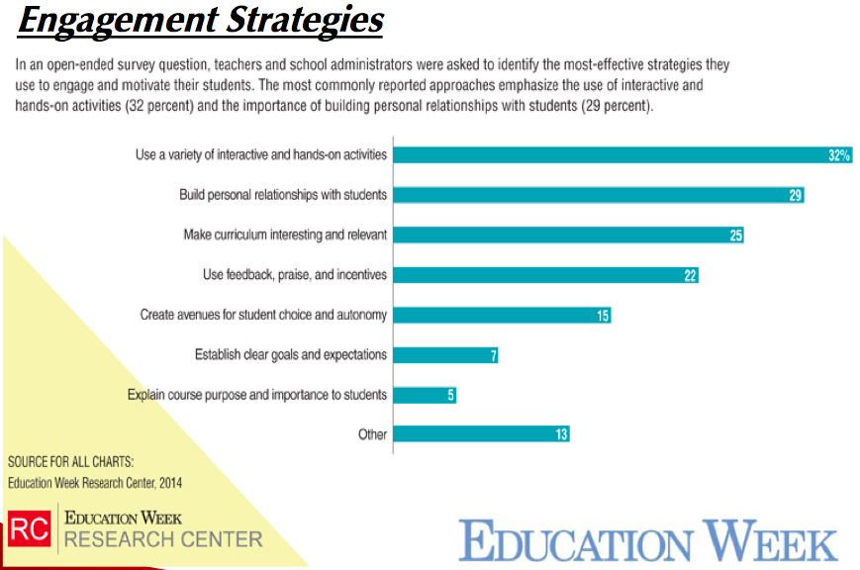
David: Discovery learning strategies

Slide 5
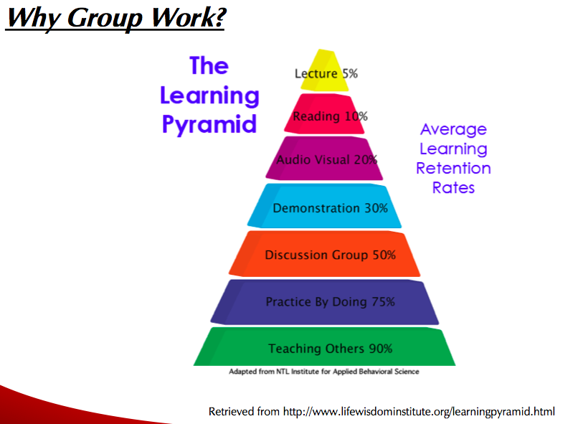

Slide 6
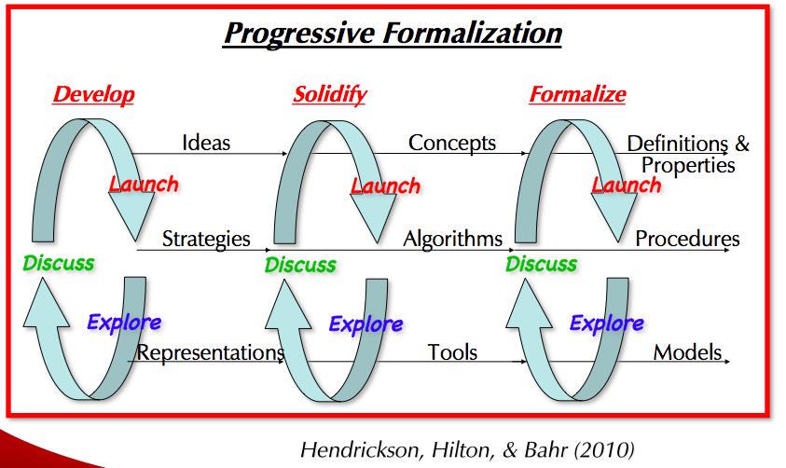

Slide 7
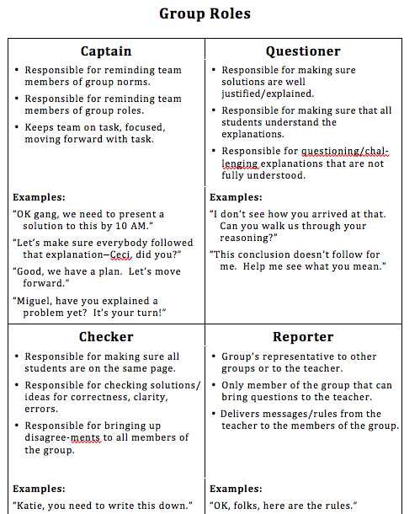

Slide 8
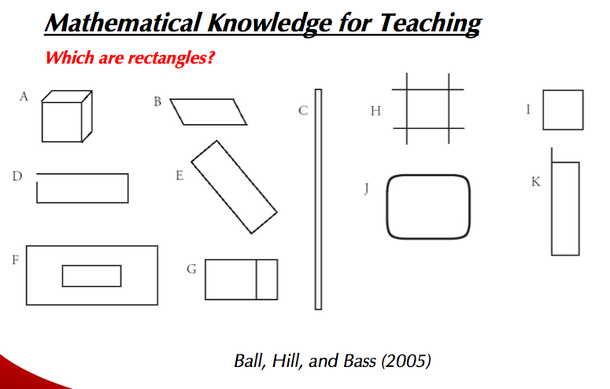

Slide 9
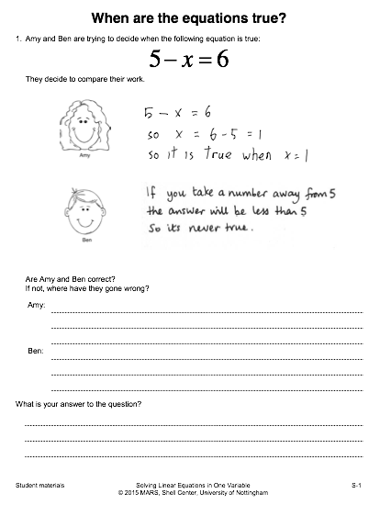

Slide 10
Jayne
Pros and Cons of Discovery Learning
Why steer away from it?
Students who are presented with problems without foundational knowledge may not have the ability to work through solutions. In fact, any learning taking place may have errors, misconceptions, or be confusing/frustrating to the learner. Students are left to self-discover the topics.
Why choose Discovery Learning?
Discovery learning promotes student exploration and collaboration with teachers and peers to solve problems. Children are also able to direct their own inquiry and be actively involved in the learning process which helps with student motivation.

Slide 11
Conclusion
Stephanie Ellerbe
When used appropriately discovery learning allows students to take an active role in their learning.
Students are actively applying their problem solving skills to make connections and solutions using past experiences or prior knowledge. This constructivist theory is based on the idea that by completing inquiry-based projects or assignments will help the students form a deeper understanding of the concepts being taught.
- Student engagement
-Motivation
- Develops creativity and problem-solving skills
- collaboration/independence
Notes:
Increases student engagement- many of the activities in inquiry based learning involves student participation
Students are more motivated as they take more of in interest in what they are learning
They learn that there is more than one way to approach a problem and they are able to apply this knowledge to real world applications
Discovery learning is versatile. It doesn’t need to be an intense lesson that requires of preparation it can be as simple as a problem of the day or an inference based activity. The activities may also be done whole group or independently.

Slide 12

Stephanie Ellerbe

