Slide 1
The Whole Child: Challenged
By: Breanna Higgins, Jacqueline Hernandez, Gracie Osorio, Rocio Uribe

Slide 2
Drawing Connections with Data
80%+ of Americans believe that high school graduates should be college/career ready
50% of high school students who had considered dropping out have claimed that they were not challenged in most of their classes
29% of students at public college are enrolled in remedial classes
Less than 50% believe they actually are
23% of high school graduates who take the Armed Forces Qualification test fail to earn a satisfactory score
In 2008, 4 out of 5 remedial students had a high school GPA of 3.0 or above

Slide 3
Students Must Be Challenged
Students need to develop skills to succeed in post-secondary education and the workplace. These skills can be developed by curriculum that challenges students to work harder as the investigate a wide range of real- world subjects. These skills include:
Higher level thinking
Communication
Problem Solving
Knowledge of the world and its people

Slide 4
Ways to Challenge Students:
Integrate technology
Incorporate public speaking
Determine prior knowledge (KWL chart, discussions)
Allow choice
  Offer a range of texts
  Ask deeper questions
  Encourage divergent thinking
Encourage goal setting
Self-Assessment

Slide 5
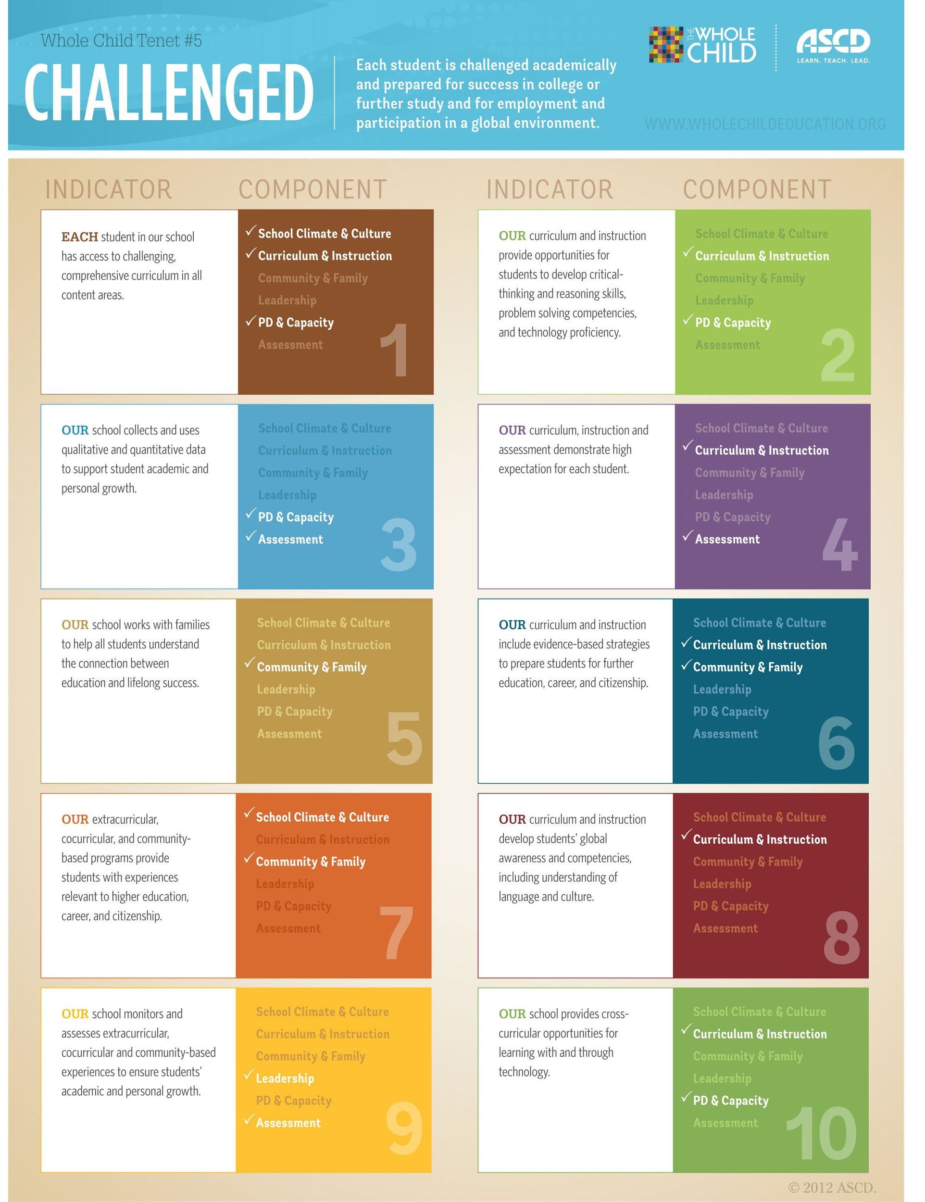
When students are academically challenged they will be prepared for success in postsecondary education and in the workplace.
The chart gives some examples of what schools and educators can do to challenge students attending the school.

Slide 6
Reference
Making the Case. (n.d.). Retrieved from
http://www.wholechildeducation.org/take-action/making-the-case/

