Slide 1
Rome’s Technology Achievements
By Luis Rodriguez
4/10/11
Hist 110

Slide 2
Roman Empire
One of the most advanced empire in Technology
Others did not match their technology therefore were not a big threat to them.
One exception “the Parthian Kingdom”

Slide 3
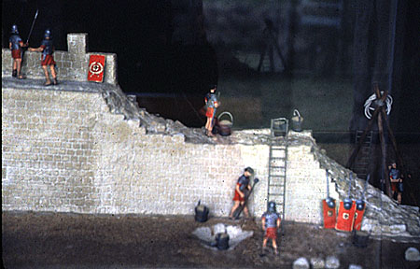
Rome Empire
Best engineers were in the army
As a result, it was the army that did most of the construction when they were in time of peace.
Kept warriors busy.

Slide 4
Roads
Miles and miles of stone roads throughout the empire.
Made easy travel
Used my merchants when trading
Used by Christians to spread their faith.

Slide 5
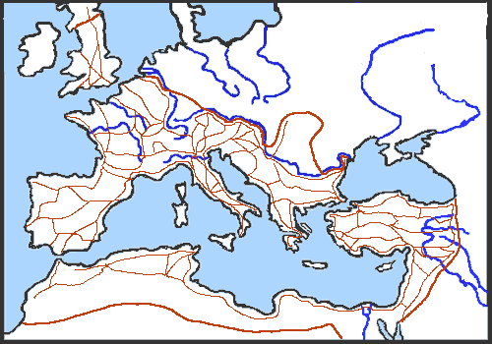
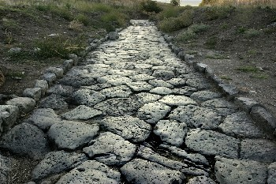
Famous Saying “All roads lead to Rome”

Slide 6
Hadrian’sWall
Protecting the borders became expensive.
Most of the empire was protected by mountains, deserts and sea.
On weak areas, 15 ft walls were build for protection.
Built to protect from intruders.
Mainly the Picts from Scotland.

Slide 7
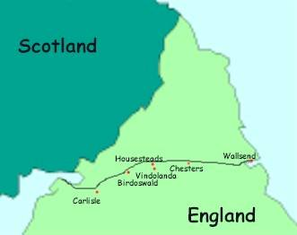
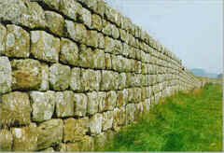
Handria’s Wall (122C.E)

Slide 8
Aqueducts
More people meant more water needed in the cities.
Aqueducts were Built during Emperor Trajan rule.
Aqueducts=Stone channels that brought water from lakes and streams into the cities.
Gravity was the only force that was used to carry water through the aqueducts.
Arches designed on the aqueducts allowed an even distribution of weight and a steady downward flow of the water.

Slide 9
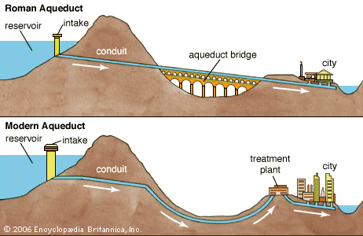
Modern vs Roman Aqueduct

Slide 10
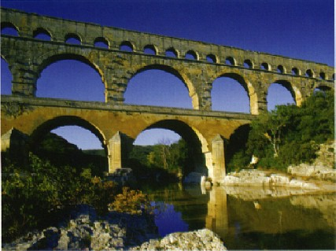
Roman Aqueduct

