Slide 1
DEFERRED ACTION FOR CHILDHOOD ARRIVALS (DACA): WHAT YOU NEED TO KNOW
PRESENTED BY:
SHARLENE MAE BAGON, ESQ.
MA. RITA S. VESAGAS, ESQ.
© 2012 Vesagas & Bagon Law Firm. All rights reserved. www.vb-lawfirm.com

Slide 2
What is Deferred Action for Childhood Arrivals (DACA)?
DACA is not a lawful status but it is a
discretionary determination by DHS to defer
removal action of an individual as an act of
prosecutorial discretion. If approved:
Individual granted DACA will not be considered to be accruing unlawful presence in the U.S. during the period deferred action is in effect.
Does not excuse previous or subsequent periods of unlawful presence.
No derivative status.
Notes:
Since discretionary, DACA can be terminated at any time at the agency’s discretion or renewed by the agency. A change in policy or administration can affect DACA.

Slide 3
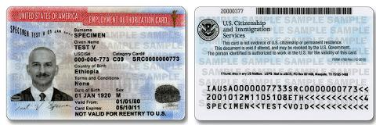
DACA
Individual granted DACA is eligible to receive employment authorization (EAD) for the period of deferred action (2 years and renewable), upon demonstrating “an economic necessity for employment.”
If EAD is granted, individual can obtain a Social Security Number.
If EAD is granted, individual may qualify to drive (varies state by state).
Notes:
Use multiple points, if necessary.

Slide 4
Who Qualifies for DACA?
Pursuant to the DHS Secretary’s June 15, 2012
memorandum, to be eligible for DACA
individuals must:
Under the age of thirty-one (31) as of JUNE 15, 2012.
< 31
Notes:
Use brief bullets and discuss details verbally.

Slide 5
Who Qualifies for DACA?
Have come to the United States under the age of sixteen (16)
< 16

Slide 6

Who Qualifies for DACA?
Have continuously resided in the United States since JUNE 15, 2007, up to the present time.
NOTE: A brief, casual, and innocent absence from the United States will not interrupt an individual’s continuous residence.

Slide 7
Continuous Presence…
If you were absent from the US for any period of time, your absence will be considered brief, casual, and innocent, if it was before August 15, 2012, and:
  Absence was of short duration and reasonably calculated to accomplish the purpose for the absence;
  Absence not result of order of deportation, removal, or grant of voluntary departure;
  The purpose of the absence and/or your actions while outside the US were not in contrary to the law;
  If traveled outside US after August 15, 2012, then not eligible for DACA.

Slide 8
Who Qualifies for DACA?
Physically present in the United States on June 15, 2012, and at the time of making your request for consideration of deferred action with USCIS.
  Can use “circumstantial” evidence to infer physical presence on June 15, 2012.
    Example: Your bank statement covering June 15, 2012 showing that an ATM withdrawal or debit card purchase was made on June 15, 2012.

Slide 9
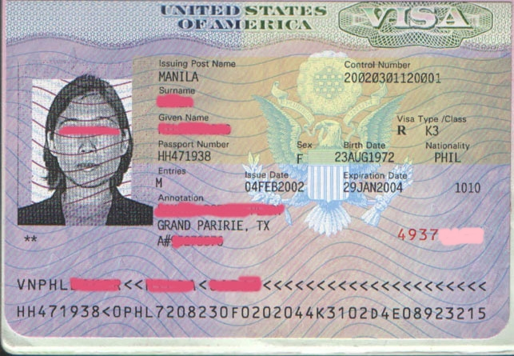
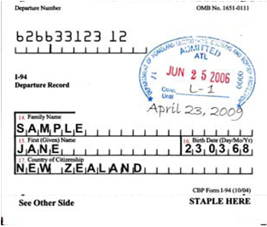
Who Qualifies for DACA?
Have entered without inspection (EWI) before June 15, 2012, or your lawful immigration status expired as of June 15, 2012.

Slide 10


Who Qualifies for DACA?
Currently in school, have graduated from high school, have obtained a general education development certificate, or you are an honorably discharged veteran of the Coast Guard or Armed Forced of the United States.

Slide 11
Currently in School…
  To be considered “currently in school”, you must be enrolled in school on the date you submit a request for consideration for DACA.
  Educational eligibility “in school” means:
    Enrollment in elementary, middle school, high school, or secondary school;
    Enrollment in an education, literacy, career training or vocational training program “designed to lead to placement in postsecondary education, job training, or employment” where the individual is working toward placement in one of these areas (e.g. ESL program if ESL is prerequisite to postsecondary education or employment);
    Enrollment in an education program that assists students in passing a GED (General Education Development) exam or other equivalent State-authorized exam.

Slide 12

Who Qualifies for DACA?
Have not been convicted of a felony, significant misdemeanor, or three or more misdemeanors, and do not otherwise pose a threat to public safety or national security.
  Felony: A Federal, State or Local offense that is punishable by imprisonment exceeding one (1) year.

Slide 13
Convictions…
  Significant Misdemeanor: A Federal, State or Local offense for which the maximum term of imprisonment authorized is one (1) year or less but greater than five (5) days, and is an offense involving:
    Domestic violence
    Sexual abuse or exploitation
    Burglary
    Unlawful possession or use of a firearm
    Drug distribution or trafficking
    DUI, or
    If not one of the offenses listed above, one for which the individual was sentenced to time in custody for more than 90 days.
      Sentence must involve time to be served in custody, and therefore does not include a suspended sentence or ICE hold.

Slide 14
Convictions…
  Non-Significant Misdemeanor: any misdemeanor as defined by Federal, State or Local offense for which the maximum term of imprisonment authorized is one year or less but greater than five (5) days, and is not an offense involving:
    Not an offense of domestic violence; sexual abuse or exploitation; burglary; unlawful possession or use of a firearm; drug distribution or trafficking; or, DUI; and
    Is one for which the person was sentenced to time in custody of 90 days or less.
  Multiple Misdemeanors: Three or more non-significant misdemeanor offenses not occurring on the same date and not arising out of the same act, omission, or scheme of misconduct.
    Traffic offenses: Minor traffic offenses will not be considered misdemeanors, but can be considered under totality of circumstances.

Slide 15
Pose a Threat…
  Threat to Public Safety or National Security
    Gang membership
    Participation in criminal activities
    Participation that threatens the U.S.
    Exception: Where DHS determines there are exceptional circumstances
  Expunged/Juvenile Convictions
    Not automatically disqualified
    Assessed on a case-by-case basis
    If tried and convicted as an adult, treated as an adult for DACA

Slide 16
DACA Application Process and Procedures
Age Requirement: Must be at least 15 years old or older to file.
  If in removal proceeding, have final order, or have received a grant of voluntary departure, and are not in detention, then the person can be under 15 years old to file for DACA.
Form Completion and Submission
  Form I-821D, Consideration of Deferred Action for Childhood Arrivals
  Form I-765, Application for Employment Authorization
  Form I-765WS

Slide 17
DACA Application Process and Procedures
Submit government filing fee in the amount of $465.00.
  Fee Waiver is NOT available for DACA considerations. However, fee exemptions are available in three limited cases:
    (a) Under 18 years old, (b) homeless, in foster care or otherwise lacking any parental or other familial support, and (c) your income is less than 150% of Federal Poverty Level (FPL);
    (a) cannot care for yourself because you suffer from a serious, chronic disability and (b) your income is less than 150% of FPL; or
    (a) have accumulated $25,000 or more in debt in the past 12 months as a result of unreimbursed medical expenses for yourself or an immediate family members and (b) your income is less than 150% of FPL.

Slide 18
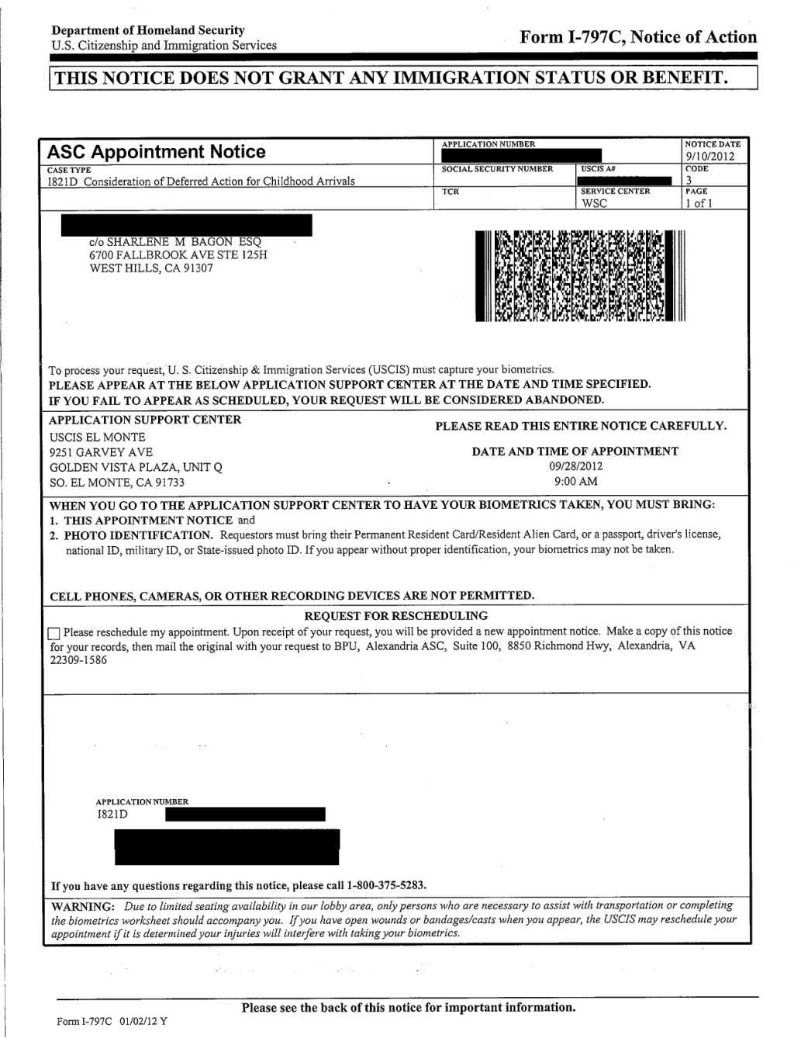
DACA Application Process and Procedures
Biometrics
Interview: No
interview
unless CSC
determines
otherwise.

Slide 19
DACA Application Process and Procedures
Adjudication: Discretionary.
  You cannot file a motion to reopen or reconsider, and cannot appeal the decision if USCIS denies your request for consideration of DACA.
  You can refile when consideration for DACA is denied.
  Removal will not be initiated if consideration for DACA is denied unless crime, fraud, threat to security and safety is involved.
Extension of DACA and EAD beyond two (2) years: Unless the program has been terminated, you may request for an extension.

Slide 20
Documents to Prove Eligibility
Birth Certificate
Passport
School or Military ID
Work ID
Financial Records (bank statements)
Medical and Dental Records
School Transcripts, Diploma, Report Cards, GED Certificate, School Awards
Military Records – Report of Separation from the Military
Employment Records (W-2, pay stubs)
Court Records, Police Reports, FBI background checks
* List is not all inclusive but is a guide to evidence generally submitted and accepted for DACA*

Slide 21
Documents to Prove Eligibility
Affidavits: Generally not sufficient on their own to demonstrate satisfaction of guidelines. However, affidavits may be used if the documentary evidence available to you is lacking or insufficient:
  A gap in documentation demonstrating that you meet the five year continuous residence requirement; and
  A shortcoming in documentation related to the brief, casual and innocent departures during the five years of required continuous presence.
    Submit two or more sworn affidavits by third parties who have direct personal knowledge of the circumstances.

Slide 22
Documents to Prove Eligibility
Affidavits will not be accepted as proof of satisfying the following guidelines:
  Currently in school, educational requirement and/or that you are an honorably discharged veteran;
  Physical presence on June 15, 2012;
  Came to the US before the age of 16;
  Under the age of 31 on June 15, 2012; and
  Criminal history.

Slide 23
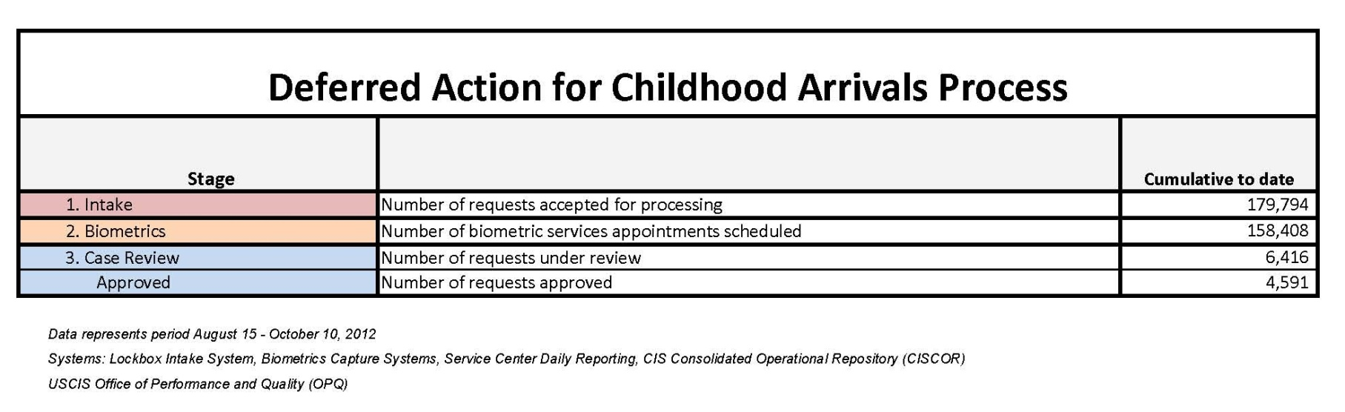
DACA UPDATES
As of October 10, 2012:
  USCIS had accepted for processing 179,794 requests for consideration of DACA.
  158,408 biometric services appointments had been scheduled
  6,416 requests under review
  4,591 requests were approved

Slide 24

Ma. Rita S. Vesagas, Esq.
Sharlene Mae Bagon, Esq.
Beverly Hills Office:
8383 Wilshire Blvd., Suite 830
Beverly Hills, CA 90211
Tel.: (323) 651-4447
Fax: (323) 651-4451
West Hills Office:
6700 Fallbrook Ave., Ste. 125H
West Hills, CA 91307
Tel.: (888) 992-2466
Fax: (888) 589-0804
Philippine Office:
Bonifacio Global City, Taguig City

