Slide 1
Music Literacy and
Music Technology
Gena Greher, University of Massachusetts, Lowell
Dan Hosken, California State University, Northridge
Scott Lipscomb, University of Minnesota
ATMI
Minneapolis, MN
Sept. 23, 2010

Slide 2
Meaning…?
How do technology and literacy interact?
How can technology foster literacy?
How can technology hinder literacy?
Can technology bypass traditional literacy?

Slide 3
Music Literacy is…
(Narrow Definition)
The ability to read and write in traditional music notation
The ability understand and use the music theory concepts that arise from this basis, such as keys, scales, intervals, cadences, roman numeral labeling, set class identification, tonal analysis, and set-class analysis

Slide 4
Music Literacy is…
(Broader Definition)
The ability to recognize/explain “high level” elements, such as the interplay of repetition, contrast, texture, phrase rhythm, and timbre
The ability to recognize/explain the multiple contexts of music-making, such as social, economic, racial, gender, historical, and spiritual

Slide 5
Three Vignettes
Music Tech class: a covert vehicle for literacy delivery
Composition class: sequencers are the enemy
Interdisciplinary class: using sound editing to leap over literacy

Slide 6
Vignette 1: Music Tech Class
Entirely music majors (lower division)
Working from notation (narrow)
Real-time entry and keyboard skills (narrow)
Score skills (narrow)
Arranging with regions/loops (broader)
Experience with mixed majors

Slide 7
Vignette 2: Composition Class
Concert composers and film composers (upper division)
Typical “style studies” class (Debussy, Stravinsky, Bartok, etc.)—all notation all the time
Sequencer scourge 1: unplayable parts
Sequencer scourge 2: un-molded improv and sequencer dumps

Slide 8
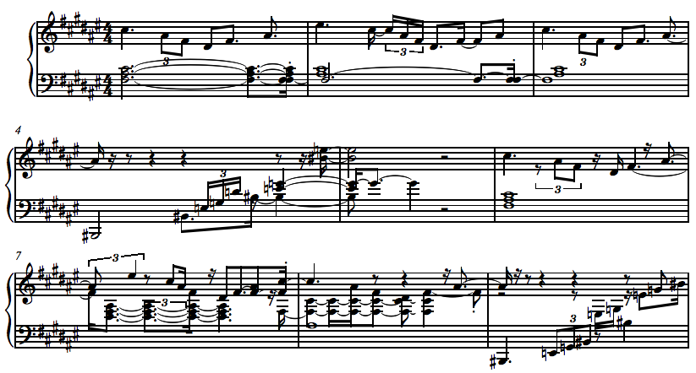
Example Sequencer Dump

Slide 9
Vignette 3: Interdisciplinary
Art students, film students, music students (upper division)
Using principles abstracted from composition to teach digital audio based sound composition (broader): ATMI 2001
Using principle abstracted from film sound design to teach… (broader): ATMI 2008
Mapping movement to sound (broader): ATMI 2006

Slide 10
And now…Scott and Gena

