Slide 1
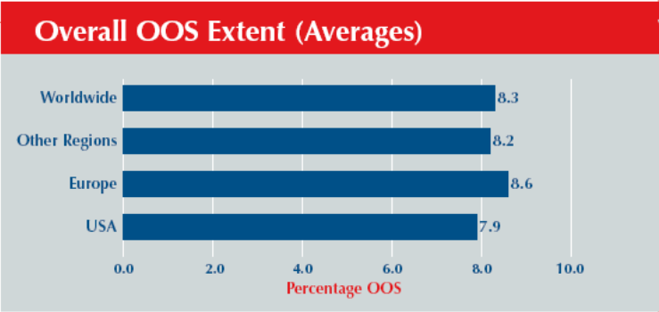
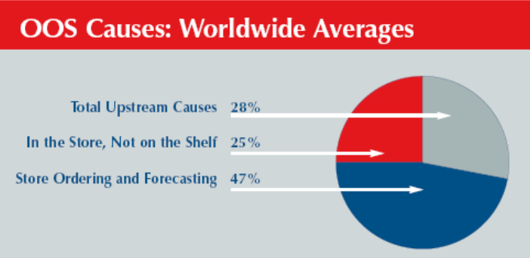
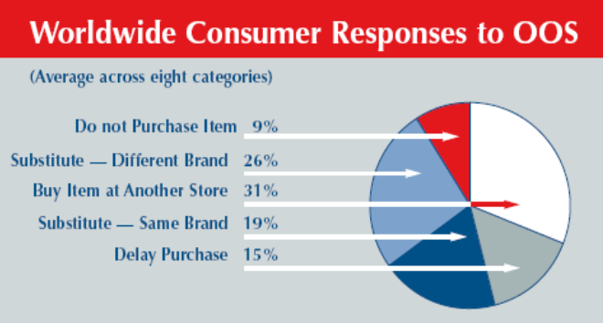
The Magnitude of Shortages (Out of Stock)

Slide 2
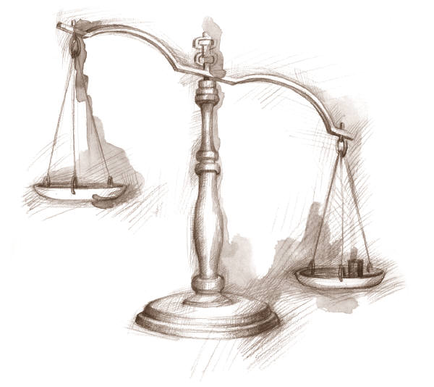
Optimal Service Level: The Newsvendor Problem
How do we choose what level of service a firm should offer?
Cost of ordering too much: holding cost, salvage
Cost of ordering too little: loss of sale, low service level
The decision maker balances the expected costs of ordering too much with the expected costs of ordering too little to determine the optimal order quantity.

Slide 3
News Vendor Model; Assumptions
  Demand is random
  Distribution of demand is known
  No initial inventory
  Set-up cost is zero
  Single period
  Zero lead time
  Linear costs
  Purchasing (production)
  Salvage value
  Revenue
  Goodwill

Slide 4
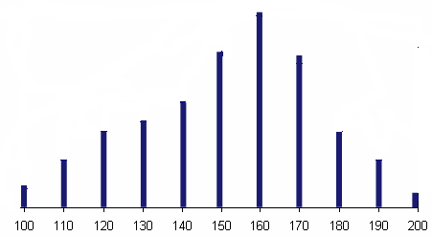
Optimal Service Level: The Newsvendor Problem
Cost =1800, Sales Price = 2500, Salvage Price = 1700
Underage Cost = 2500-1800 = 700, Overage Cost = 1800-1700 = 100
0.09
What is probability of demand to be equal to 130?
What is probability of demand to be less than or equal to 140?
What is probability of demand to be greater than or equal to 140?
What is probability of demand to be equal to 133?
0.35
0.02+0.05+0.08+0.09+0.11=
1-0.35+0.11=
0.76
0
P(R ≥ Q ) = 1-P(R ≤ Q)+P(R = Q)
R is quantity of demand
Q is the quantity ordered

Slide 5
Optimal Service Level: The Newsvendor Problem
0.005
What is probability of demand to be equal to 116?
What is probability of demand to be less than or equal to 116?
What is probability of demand to be greater than or equal to 116?
What is probability of demand to be equal to 113.3?
0.02+0.035 =
0.055
1-0.055+0.005 =
0.95
0

Slide 6
Optimal Service Level: The Newsvendor Problem
What is probability of demand to be equal to 130?
0
What is probability of demand to be less than or equal to 145?
0.02+0.05+0.08+0.09+0.11 =
0.35
What is probability of demand to be greater than or equal to 145?
1-0.35 =
0.65
P(R ≥ Q) = 1-P(R ≤ Q)

Slide 7
Compute the Average Demand
Average Demand =
+100×0.02 +110×0.05+120×0.08 +130×0.09+140×0.11 +150×0.16
+160×0.20 +170×0.15 +180×0.08 +190×0.05+200×0.01
Average Demand = 151.6
How many units should I have to sell 151.6 units (on average)?
How many units do I sell (on average) if I have 100 units?
200
100

Slide 8
Suppose I have ordered 140 units.
On average, how many of them are sold? In other words, what is the expected value of the number of sold units?
When I can sell all 140 units?
I can sell all 140 units if ➔ R ≥ 140
Prob(R ≥ 140) = 0.76
The expected number of units sold –for this part- is
(0.76)(140) = 106.4
Also, there is 0.02 probability that I sell 100 units➔ 2 units
Also, there is 0.05 probability that I sell 110 units➔5.5
Also, there is 0.08 probability that I sell 120 units➔ 9.6
Also, there is 0.09 probability that I sell 130 units➔ 11.7
106.4 + 2 + 5.5 + 9.6 + 11.7 = 135.2

Slide 9
Suppose I have ordered 140 units.
On average, how many of them are salvaged? In other words, what is the expected value of the number of salvaged units?
0.02 probability that I sell 100 units.
In that case 40 units are salvaged ➔ 0.02(40) = .8
0.05 probability to sell 110 ➔ 30 salvaged ➔ 0.05(30)= 1.5
0.08 probability to sell 120 ➔ 20 salvaged ➔ 0.08(20) = 1.6
0.09 probability to sell 130 ➔ 10 salvaged ➔ 0.09(10) =0.9
0.8 + 1.5 + 1.6 + 0.9 = 4.8
Total number Sold 135.2 @ 700 = 94640
Total number Salvaged 4.8 @ -100 = -480
Expected Profit = 94640 – 480 = 94,160

Slide 10
Cumulative Probabilities

Slide 11
Number of Units Sold, Salvaged
Sold@700
Salvaged@-100

Slide 12
Total Revenue for Different Ordering Policies

Slide 13
Denim Wholesaler; Marginal Analysis
The demand for denim is:
  1000 with probability 0.10
  2000 with probability 0.15
  3000 with probability 0.15
  4000 with probability 0.20
  5000 with probability 0.15
  6000 with probability 0.15
  7000 with probability 0.10
Unit Revenue (p ) = 30
Unit purchase cost (c )= 10
Salvage value (v )= 5
Goodwill cost (g )= 0
How much should we order?

Slide 14
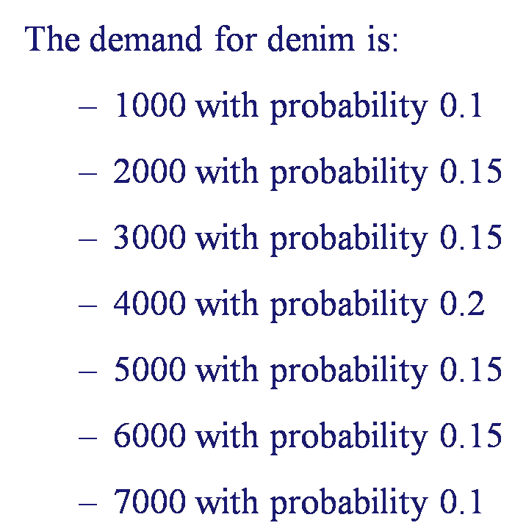
Marginal Analysis
Marginal analysis: What is the value of an additional unit ordered?
Suppose the wholesaler purchases 1000 units
What is the value of having the 1001st unit?
Marginal Cost: The retailer must salvage the additional unit and losses $5 (10 – 5).
P(R ≤ 1000) = 0.1
Expected Marginal Cost = 0.1(5) = 0.5

Slide 15
Marginal Analysis
Marginal Profit: The retailer makes and extra profit of $20 (30 – 10)
P(R > 1000) = 0.9
Expected Marginal Profit= 0.9(20) = 18
MP ≥ MC
Expected Value = 18-0.5 = 17.5
  By purchasing an additional unit, the expected profit increases by $17.5
The retailer should purchase at least 1,001 units.

Slide 16
Marginal Analysis
Should he purchase 1,002 units?
Marginal Cost: $5 salvage ➔ P(R ≤ 1001) = 0.1
Expected Marginal Cost = 0.5
Marginal Profit: $20 profit ➔ P(R >1002) = 0.9 ➔ 18
Expected Marginal Profit = 18
Expected Value = 18-0.5 = 17.5
Assuming that the initial purchasing quantity is between 1000 and 2000, then by purchasing an additional unit exactly the same savings will be achieved.
Conclusion:
Wholesaler should purchase at least 2000 units.

Slide 17
Marginal Analysis
Marginal analysis: What is the value of an additional unit ordered?
Suppose the retailer purchases 2000 units
What is the value of having the 2001st unit?
Marginal Cost: The retailer must salvage the additional unit and losses $5 (10 – 5).
P(R ≤ 2000) = 0.25
Expected Marginal Cost = 0.25(5) = 1.25

Slide 18
Marginal Analysis
Marginal Profit: The retailer makes and extra profit of $20 (30 – 10)
P(R > 2000) = 0.75
Expected Marginal Profit= 0.75(20) = 15
MP ≥ MC
Expected Value = 15-1.25 = 13.75
  By purchasing an additional unit, the expected profit increases by $13.75
The retailer should purchase at least 2,001 units.

Slide 19
Marginal Analysis
Should he purchase 2,002 units?
Marginal Cost: $5 salvage ➔ P(R ≤ 2001) = 0.25
Expected Marginal Cost = 1.25
Marginal Profit: $20 profit ➔ P(R >2002) = 0.75
Expected Marginal Profit = 15
Expected Value = 15-1.25 = 13.75
Assuming that the initial purchasing quantity is between 2000 and 3000, then by purchasing an additional unit exactly the same savings will be achieved.
Conclusion:
Wholesaler should purchase at least 3000 units.

Slide 20
Marginal Analysis
Why does the marginal value of an additional unit decrease, as the purchasing quantity increases?
  Expected cost of an additional unit increases
  Expected savings of an additional unit decreases

Slide 21
Marginal Analysis
What is the optimal purchasing quantity?
  Answer: Choose the quantity that makes marginal value: zero
Marginal value
17.5
13.75
10
5
1.3
Quantity
-2.5
1000
2000
3000
4000
5000
6000
7000
8000
-5

Slide 22
Additional Example
On consecutive Sundays, Mac, the owner of your local newsstand, purchases a number of copies of “The Computer Journal”. He pays 25 cents for each copy and sells each for 75 cents. Copies he has not sold during the week can be returned to his supplier for 10 cents each. The supplier is able to salvage the paper for printing future issues. Mac has kept careful records of the demand each week for the journal. The observed demand during the past weeks has the following distribution:

Slide 23
Additional Example
a) How many units are sold if we have ordered 7 units
There is 0.18 + 0.20 + 0.10 + 0.10 + 0.08 + 0.04 + 0.04 = 0.74
There is 0.74 probability that demand is greater than or equal to 7.
There is 0.16 probability that demand is equal to 6.
There is 0.06 probability that demand is equal to 5.
There is 0.04 probability that demand is equal to 4.
The expected number of units sold is
0.74(7) + 0.16 (6) + 0.06 (5) + 0.04 (4) = 6.6

Slide 24
Additional Example
b) How many units are salvaged?
7-6.6 = 0.4. Alternatively, we can compute it directly
There is 0.74 probability that we salvage 7 – 7 = 0 units
There is 0.16 probability that we salvage 7- 6 = 1 units
There is 0.06 probability that we salvage 7- 5 = 2 units
There is 0.04 probability that we salvage 7-4 = 3 units
The expected number of units salvaged is
0.74(0) + 0.16 (1) + 0.06 (2) + 0.04 (3) = 0.4 and 7-0.4 = 6.6 sold

Slide 25
Additional Example
c) Compute the total profit if we order 7 units.
Out of 7 units, 6.6 sold, 0.4 salvaged.
P = 75, c= 25, v=10.
Profit per unit sold = 75-25 = 50
Cost per unit salvaged = 25-10 = 15
Total Profit = 6.6(50) + 0.4(15) = 330 - 6 = 324

Slide 26
Additional Example
d) Compute the expected Marginal profit of ordering the 8th unit.
MP = 75-25 = 50
P(R ≥ 8) = 0.2 + 0.1 + 0.1 + 0.08 + 0.04 + 0.04 = 0.56
Expected Marginal profit = 0.56(50) = 28
e) Compute the expected Marginal cost of ordering the 8th unit.
MC = 25 – 10 = 15
P(R ≤ 7) = 1-0.56 = 0.44
Expected Marginal cost = 0.44(15) = 6.6

Slide 27
Another Example
Swell Productions (The Retailer) is sponsoring an outdoor conclave for owners of collectible and classic Fords. The concession stand in the T-Bird area will sell clothing such as official Thunderbird racing jerseys. The following table shows the probability of jerseys sales quantities.
Probability | 0.05 | 0.10 | 0.30 | 0.20 | 0.20 | 0.15
Demand | 100 | 200 | 300 | 400 | 500 | 600
A) Compute the average demand (units that can be sold) for Swell Productions jerseys.

Slide 28
Another Example
B) Given the average demand you have obtained in the previous part. How many units should Swell Productions order to be able to have the average number of units sold equal to the average demand.
600
C) Supposed Swell Productions has ordered 400 units. Compute the marginal profit of ordering one more unit.
40(0.35) = 14

Slide 29
Another Example
D) Supposed Swell Productions has ordered 400 units. Compute the marginal cost of ordering one more unit.
20(0.65) = 13
E) Suppose your computations indicates that it is at Swell Productions’ benefit to order 401 units (this may or may not the correct answer). How many units should Swell Productions order?
500

Slide 30
Another Example
F) Suppose Swell Productions has ordered 500 units. Compute the expected value of the number of units salvaged.
0.05(400)+0.1(300) +0.3 (200) + 0.2 (100) =
20+30+60+20 = 130
G) Suppose Swell Productions orders 500 jerseys. Compute the expected number of jerseys that can be sold.
500-130= 370

Slide 31
Another Example
H) Supposed Swell Productions has ordered 500 units. Compute the expected value of Swell Productions’ total net profit.
-130(20) + 370(40) = -2600+ 14800 = 12200
I) At what purchasing price (current purchasing price is $40 and current salvage value is 20) will you order 600 units?
MC=0.85 (c-20) = 0.85c -17
MP = 0.15(80-c) = 12- 0.15c
12-0.15c> 0.85c-17
29> c

Slide 32
Another Example
It really does not make sense to say the break-even point is where
385(40) = 215X. Because X and 40 are not independent.
To correct the above statement, one may say: the break-even point is where 385(80-c) = 215(c-20)
One may try to solve the above equation. But it does not make sense because in that case and under the price of c, we will make 0 profit if we order 600. While we already make $12200, by ordering 500. Therefore no matter what c value comes out of the above equation, it makes our profit equal 0. Why we should order 600 for 0 profit compared to 500 with $12200 profit.

Slide 33
Another Example
A correct second procedure to solve the problem is to say; we order 600 if its total expected revenue is greater than ordering 500.
Ordering 500 ➔ # of units sold is 370 and salvaged 130
Ordering 600 ➔ # of units sold is 385 and salvaged 215
For sale we get (80-c) for salvage we pay (c-20)
Therefore, total revenue of 600 must be greater than that of 500
385(80-c) – 215(c-20) > 370(80-c) – 130(c-20)
By solving this equation we will get 29>c

Slide 34
Another Example
Indeed we could have also said that by ordering 600 we sell 15 units more and salvage 85 units more. And the sale revenue must be greater than salvaged marginal cost
15(80-c) > 85(c-20)
29>c

